Slide 1
SQL Server AlwaysOn
Gianluca Hotz
@glhotz
http://www.ugiss.org

Slide 2






Sponsors

Slide 3

Organizers

Slide 4


Speaker
Gianluca Hotz
Consultant and mentor at SolidQ
Administration, capacity planning, data modeling, development, optimization
Almost 20 years on SQL Server (from 4.21 in 1996)
Interests
Relational model, DBMS architectures, high availability and disaster recovery
Microsoft MVP SQL Server since 1998
Founder & vice-president UGISS
User Group Italiano SQL Server
Official Italian PASS Chapter
Mail: ghotz@ugiss.org - ghotz@solidq.com

Slide 5
Agenda
Introduction
AlwaysOn FCI
AlwaysOn AG
AlwaysOn Advanced Scenarios

Slide 6
AlwaysOn
Introduction
New name for HA and DR technologies
Failover Cluster Instance (FCI)
Availability Groups (AG)
For the purpose of this presentation
High Availability (local HA): in a data center
Disaster Recovery: across data centers

Slide 7
AlwaysOn FCI
FCI Brief review
Protects an entire SQL Server instance
Requires Shared Storage
Geographic DR with SQL Server < 2012
Proprietary solutions for Stretch V-LAN
Proprietary solutions for storage replication
Multi-subnet support >=2012

Slide 8
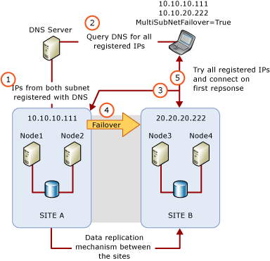
AlwaysOn FCI
Multi-Subnet Support
Nodes on different subnets
IP Address resources in OR
Still needs data replication
Requires Enterprise Edition
http://msdn.microsoft.com/en-us/library/ff878716.aspx

Slide 9
AlwaysOn FCI
Multi-Subnet Support: how do clients reconnect?
New clients
Try IP addresses in order
Avoid DNS update latencies
New connection string parameter
MultiSubnetFailover=True
Try IP addresses in parallel
Check driver support!
Old clients
Change timeout value
Reduce DNS updates latency (HostRecordTTL)
Reduce DNS cache expiration on the client
http://msdn.microsoft.com/en-us/library/ff878716.aspx

Slide 10
AlwaysOn FCI
Failover policies in SQL Server <= 2008
Looks Alive
Checks service state (Service Control Mgr.)
Every 5 seconds
IsAlive
Checks SELECT @@SERVERNAME
Every 60 seconds
Can pass check even when not responding to other incoming requests
e.g. stuck schedulers

Slide 11
AlwaysOn FCI
Flexible failover policies in SQL Server >= 2012
IsAlive based on system procedure
Resource DLL calls sp_server_diagnostic
Over a dedicated connection
Diagnostic information from procedure
New instance parameter FailureConditionLevel
Allows selecting conditions for failover to occur
Timeouts while calling diagnostic procedure
New Cluster parameter HealthCheckTimeout

Slide 12
AlwaysOn FCI
Failure condition levels
Level | Condition | Description
0 | No automatic failover or restart | Never Failover (system maintenance only)
1 | Failover or restart on SQL Server down | Service down
2 | Failover or restart on SQL Server unresponsive | Server hanged (sp_server_diagnostics not responding within HealthCheckTimeout setting)
3 | Failover or restart on critical SQL Server errors | System unhealthy (sp_server_diagnostics “system error”)
4 | Failover or restart on moderate SQL Server errors | Resource unhealthy (sp_server_diagnostics “resource error”)
5 | Failover or restart on any qualified failure | QP Unhealthy (sp_server_diagnostics “query_processing error”)

Slide 13
AlwaysOn FCI
Flexible failover policies configuration
Failover Cluster Manager
PowerShell
Get-ClusterResource $SqlName
| Set-ClusterParameter HealthCheckTimeout 60000
| Set-ClusterParameter FailureConditionLevel 3
T-SQL
ALTER SERVER CONFIGURATION SET FAILOVER CLUSTER PROPERTYHEALTHCHECKTIMEOUT = 60000;
ALTER SERVER CONFIGURATION SET FAILOVER CLUSTER PROPERTY FAILURECONDITIONLEVEL = 3;

Slide 14
AlwaysOn FCI
Reducing planned downtime with SQL Server >= 2012
Windows Core Support
Less patches to be installed (circa 50-60%)
Support for rolling upgrading and patching
Better control on failover time
Indirect Checkpoints
ALTER DATABASE … SET TARGET_RECOVERY_TIME = …

Slide 15
AlwaysOn FCI
New Storage options with SQL Server >= 2012
Tempdb on local storage
Can leverage fast SSD cards
SMB shares supported
Best on
Windows Server 2008 R2 (SMB 2.1 + Hotfix)
Windows Server 2012
Azure
Asymmetric Disks
Notes:
Asymmetric Disks are also here so that we can either talk briefly about them for a shorter presentation without the advanced patterns, or we can simply say we’ll discuss them later.

Slide 16
AlwaysOn FCI
Failover Cluster Instances in SQL Server >= 2014
Support for Windows Server 2012 CSV
Support for FCI in Sysprep
Same support as for Availability Groups in
sys.dm_hadr_cluster
sys.dm_hadr_cluster_members
sys.dm_hadr_cluster_networks
New DMV
sys.dm_io_cluster_valid_path_names

Slide 17
AlwaysOn AG
Data replicas review
Log Shipping
Replication
Database Mirroring
Availability Groups
>= SQL Server 2012

Slide 18
AlwaysOn AG
Key evaluation factors for data replication
Granularity
Instance, database, table, subset of table…
Reliability
Number of replicas, synchronous…
Performance
Asynchronous, off-load activities
Manageability
Setup, management, number of moving parts…
Failover transparency
Manual, automatic, coordinated between parts…

Slide 19
AlwaysOn AG
Log Shipping
Advantages
Entire database replicas
Multiple replicas per database
Simple and robust
Disadvantages
Only asynchronous replicas
Readable replicas with trade-offs
Updated to last log restore
Need to disconnect clients before restoring
Notes:
Robust: if you don’t trust transaction log mechanisms and backup/restore mechanism…

Slide 20
AlwaysOn AG
Replication
Advantages
More granular (depends on scenario)
Multiple replicas
Readable & updateable replicas
Disadvantages
More granular (depends on scenario)
Only asynchronous replicas
Typically higher latency
Complexity and maintenance overhead
Notes:
I stress that it’s not really an option, it’s here for completeness, because historically lot of people tried using it for DR and in some cases it can be an option (think reduced data to replicate for VLDB with lot of historical/less likely touched data, ok there are other options too…)
Another good case could be for data federation: underlying infrastructure, e.g. P2P, to have multiple replicas (redundancy for DR) and data distribution (scalability).
I also don’t want to discourage it’s usage, so I stress that in many cases it’s very simple to set it up and has very intuitive model and GUIs but when you have problems, or when you need to tune it, you need to know every knob very well. The GUI does a great job to simplify the architecture complexity, still you can’t really avoid to learn it.

Slide 21
AlwaysOn AG
Database Mirroring
Advantages
Entire database replicas
Synchronous and asynchronous (EE) replicas
Simple and robust
Disadvantages
Only one replica per database
Readable replicas need Database Snapshot
Enterprise Edition
Updated to last snapshot creation time
Need to disconnect or handle multiple snapshot names
Notes:
Robust: if you don’t trust transacton log mechanisms and backup/restore mechanism….

Slide 22
AlwaysOn AG
Common Problems
Manual Failover*
No coordination to failover multiple DBs
No backups on replicas*
Specific limitations
E.g. FILESTREAM, cross-database consistency of transactions, only one replica
Notes:
The asterisc is there because Mirroring has automatic failover. However, it’s a though call: perception is that the witness can simply be a stand-alone machine with SQL Express. However, if Witness is lost, Quorum is lost and Database Mirroring stops serving incoming requests. So it’s like a single point of failure unless you also protect it (ok, with VMs it can be simpler, still…) Moveover, there has been a lot of problems with client-side connectivity and reconnects (e.g. with connection pooling) so in a lot of cases people simply didn’t took it as a real option.
Other asterisc: technically backups can be taken on subscribers (replication), so it’s really no backups on replicas for log shipping/mirroring and no up to date backups with Replication.

Slide 23
AlwaysOn AG
AG as evolution of Database Mirroring
Coordinated failover of multiple DBs
Multiple replicas (up to 4 in 2012 and 8 in 2014)
Synchronous/asynchronous replicas
Up-to-date readable replicas
Ability to off-load maintenance on replicas e.g. backups

Slide 24
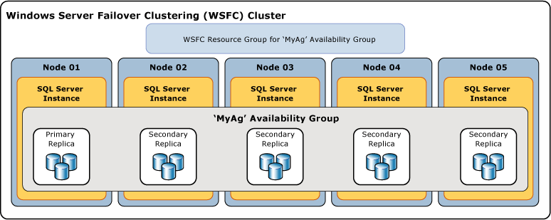
AlwaysOn AG
AG Overview
http://msdn.microsoft.com/en-us/library/ff877884.aspx

Slide 25
AlwaysOn AG
Windows Server Failover Clustering (WSFC)
Used by Availability Groups for
Primary health detection
Inter-node health detection
Failover coordination
Distributed data store for settings and state
Distributed change notifications between nodes

Slide 26
AlwaysOn AG
Groups and databases
Availability Group
Set of availability databases failover over together
Availability Database
Database belonging to an availability group
Primary Database
Read/write copy of an availability database
Secondary Database
Read only copy of an availability database
Notes:
Following (2 slides) is a series of definitions more compact, but less precise, of the terms you can find in BOL. I’m not sure whether to leave it as is, it’s good too have some reminders but the definitions in BOL are much better. Once we talk more often, we may condens them in one slide (without the short description) and simply talk about them.
You choose what to do, if you feel enough confortable, simply drop them and talk about them in the overview slide (with the picture).

Slide 27
AlwaysOn AG
Replicas
Availability Replica
Instance of availability group hosted on a specific SQL Server instance
Primary Replica
Makes primary databases available in read/write
Send log records to synchronize secondary replicas
Secondary Replica
Maintains read/only copies of availability DBs

Slide 28
AlwaysOn AG
Connectivity
Availability Group Listener
Virtual server name to access replicas
Managed by WSFC
Mirroring Endpoint
Used to send log records
Synchronization mechanism similar to Database Mirroring
Notes:
In future, I’ll add a slide with a diagram showing log records flow, like the one we had for mirroring but updated.

Slide 29
AlwaysOn AG
Availability Group Listener
Defined by
Virtual Network Name (VNN)
TCP Port
One or more IP addresses (static or DHCP)
Client connection
Application Intent allows automatic routing
Support for Mirroring connection string
SPN registration automatic for Kerberos auth.

Slide 30
AlwaysOn AG
Synchronization and Failover
Availability Mode
Synchronous
Asynchronous
Failover mode
Automatic
Manual
Forced

Slide 31
AlwaysOn AG
Conditions for Automatic Failover
Primary and Secondary need
Synchronous Availability Mode configuration
Automatic Failover configuration
To be synchronized
WFSC needs to reach a quorum
Failover policies met
Leverages FCI mechanism

Slide 32
AlwaysOn AG
Flexible failover policies for Availability Groups
Leverages FCI mechanism
sp_server_diagnostic
Configuration in T-SQL
ALTER AVAILABILITY GROUP … SET (HEALTH_CHECK_TIMEOUT = 30000);
ALTER AVAILABILITY GROUP … SET (FAILURE_CONDITION_LEVEL = 3);

Slide 33
AlwaysOn AG
Failure condition levels for Availability Groups
On server down
On server unresponsive
On critical server error
On moderate server error
On any qualified failure conditions
Notes:
I’m not happy with this one. If for anything, it should be consisent with the table prepared for FCI. However, I added this one right now while translating (not included in my original presentation). I will think at how to make it better in future. Right now take it as is or simply hide it and leave the «similar to FCI» in the previous slide. Oh, or make it better ☺

Slide 34
AlwaysOn AG
Replicas and backups
Backup support on secondary replicas
Full backups with COPY_ONLY
Differential not supported!
Log backups
Form a single log-chain across all replicas
Automated Backup Preference & Priority
No immediate effect
Backup scripts need to query UDF
sys.fn_hadr_backup_is_preferred_replica('dbname')

Slide 35
AlwaysOn AG
Read-Only Access
Replicas roles
Primary: READ_WRITE | ALL
Secondary: NO | READ_ONLY | ALL
New connection property
ApplicationIntent
Name slightly different across client APIs
Read-Only Routing

Slide 36

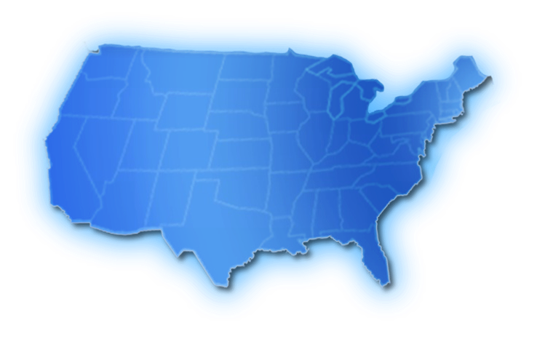




AlwaysOn AG
Topology example 1
A
A
A
A
Direct attached storage local, regional and geo secondaries
Synchronous
data movement
Asynchronous data movement

Slide 37
AlwaysOn AG
Read-Only Access Capacity Planning
Synchronization latency of replica can raise because of the read I/O activity
Impact on tempdb
Temporary statistics
Automatically created
Gone after failover
Read Committed Snapshot Isolation
14 bytes added to rows at primary (on updates)

Slide 38
AlwaysOn AG
Problem with replicas at database level
Need Manual synchronization for objects outside database scope
New logins/users
Jobs
Solution for logins/users
Contained databases
Problem with ApplicationIntent=ReadOnly

Slide 39
AlwaysOn AG
Contained Database
Allows databases isolation
Remove dependecies from instance objects
It’s a databases level property
Only partial support in SQL Server 2012
DMV/Extended Event to find non contained entities
Main usage: database level authentication
Login not needed, user is used instead
Needs to be permitted at instance level

Slide 40
AlwaysOn AG
Interoperability with Analysis Services
No support for native storage
Common pattern: NLB and custom replica
Official architectural guide from 2008 http://download.microsoft.com/download/A/5/7/A575AD7C-4172-42D0-8D58-0698D6802F81/SSASReadOnlyDBs.docx
In general, data sources need to point to listener
Workload off-loading needs to specify ApplicationIntent

Slide 41
AlwaysOn AG
Interoperability with Reporting Services
Support for database used by reports
Data sources point to listener
Data sources may specify ApplicationIntent
Limited support for RS databases
No automatic fail-over
Common pattern: scale-out deployment with FCI and AG

Slide 42
AlwaysOn AG
Interoperability with SSIS Catalog
No support out-of-the-box
Needs custom failover procedure
http://blogs.msdn.com/b/mattm/archive/2012/09/19/ssis-with-alwayson.aspx

Slide 43
AlwaysOn AG
Demo
Primary Datacenter
Primary replica
Secondary replica for HA and reporting
Secondary Datacenter
Secondary replica for DR
Notes:
In the current version of the demo, the secondary replica in the secondary datacenter is actually on the same sub-net. I would say this is not a practical scenario as you still need some proprietary stretched VLAN technology. OTOH building the multi-subnet scenario requires routing (e.g. with Windows Remote Access role or a Linux VM) and such a demo is being built (also covering full multi-site FCI+AG).

Slide 44
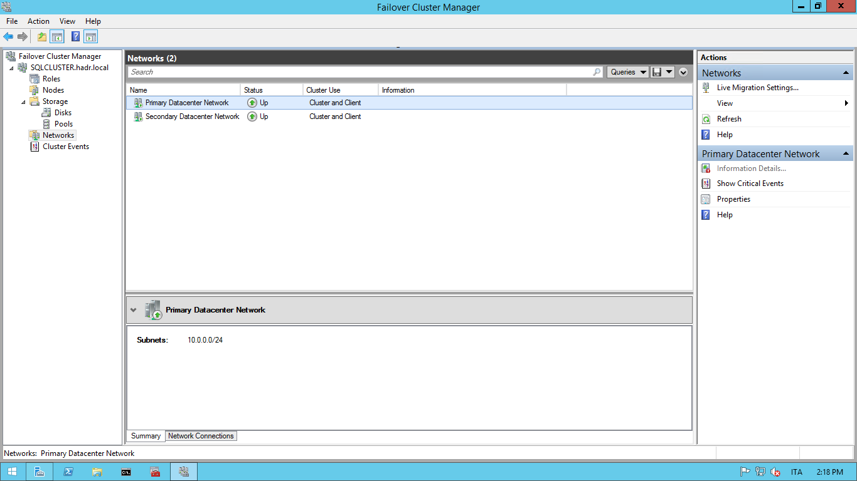
Step-by-step AG
Cluster configuration before starting: network primary datacenter

Slide 45
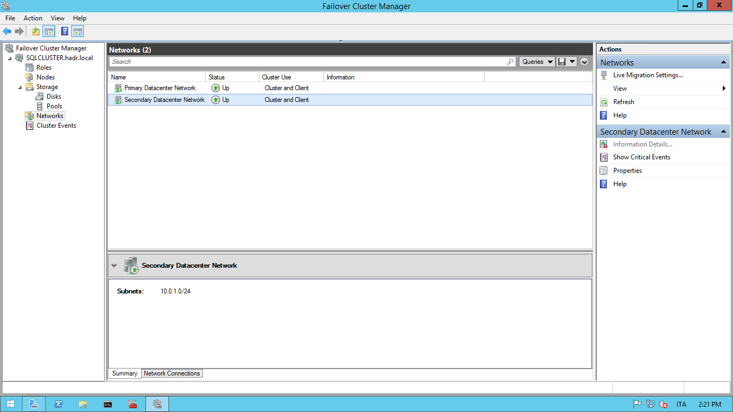
Step-by-step AG
Cluster configuration before starting: network secondary datacenter

Slide 46
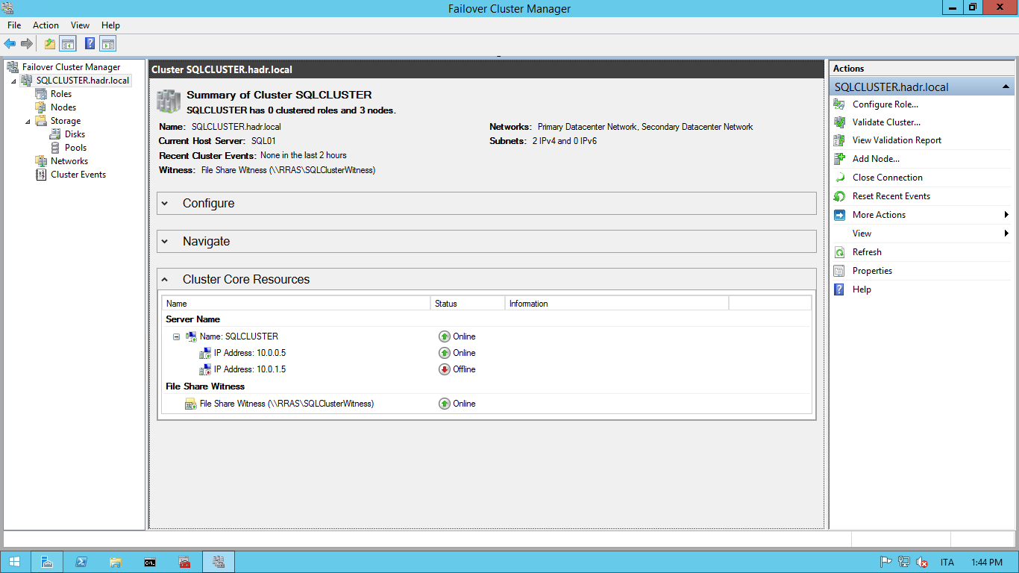
Step-by-step AG
Cluster configuration before starting: summary

Slide 47
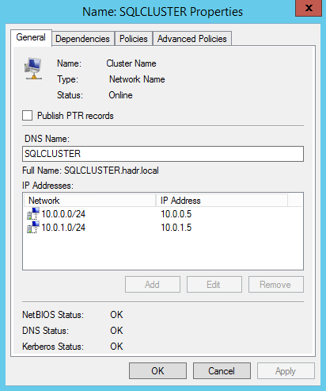
Step-by-step AG
Cluster configuration before starting: network name general

Slide 48
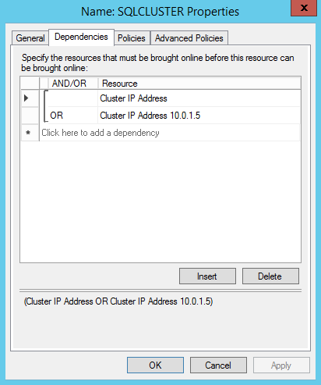
Step-by-step AG
Cluster configuration before starting: network name dependencies

Slide 49
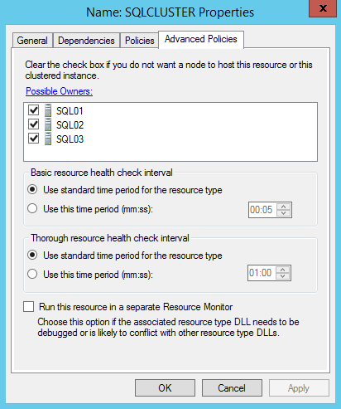
Step-by-step AG
Cluster configuration before starting: network advanced policies

Slide 50
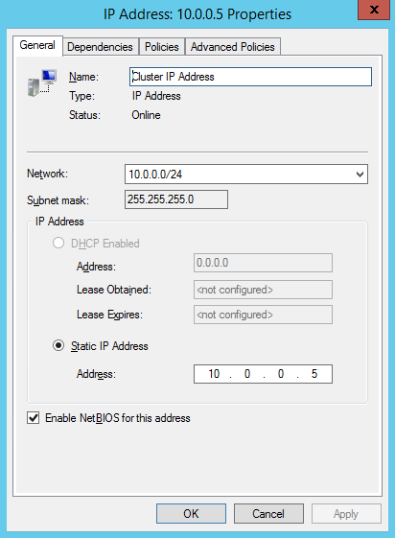
Step-by-step AG
Cluster configuration before starting: primary IP address general

Slide 51
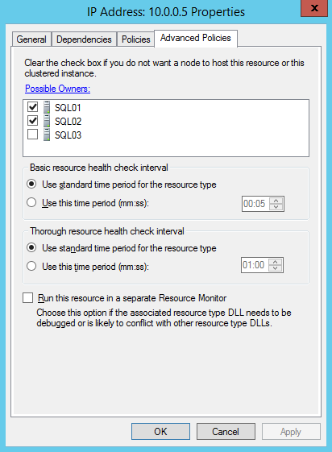
Step-by-step AG
Cluster configuration before starting: primary IP address advanced policies

Slide 52
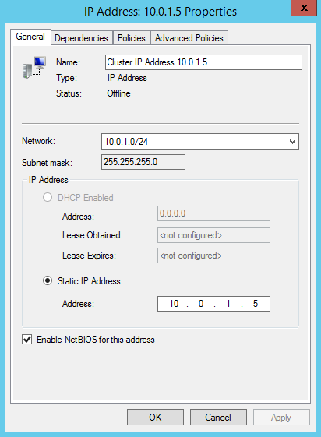
Step-by-step AG
Cluster configuration before starting: secondary IP address general

Slide 53

Step-by-step AG
Cluster configuration before starting: secondary IP address general

Slide 54
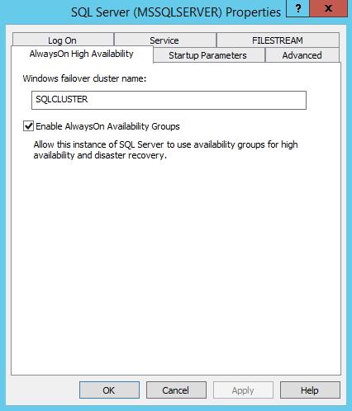
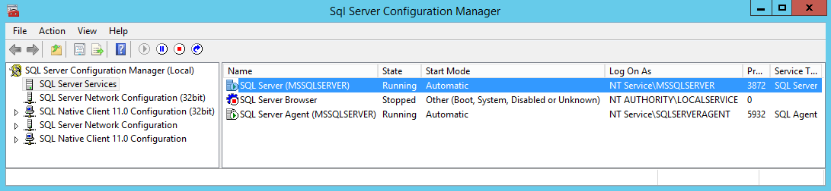
Step-by-step AG
Enable AlwaysOn
Enable option
Restart Services
Notes:
The script can take between half a minute and 2 minutes. For my presentation, I choose to run it before starting the presentation and only show the script + Configuration Manager AG property pane.

Slide 55
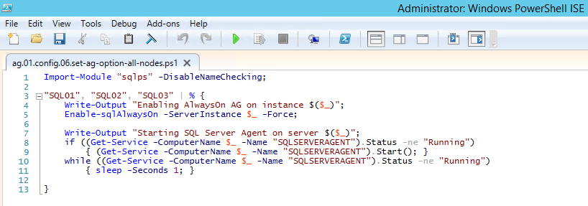
Step-by-step AG
Enable AlwaysOn with PowerShell
Use -Force to restart service
Still need to restart SQL Agent service
Notes:
The script can take between half a minute and 2 minutes. For my presentation, I choose to run it before starting the presentation and only show the script + Configuration Manager AG property pane.

Slide 56
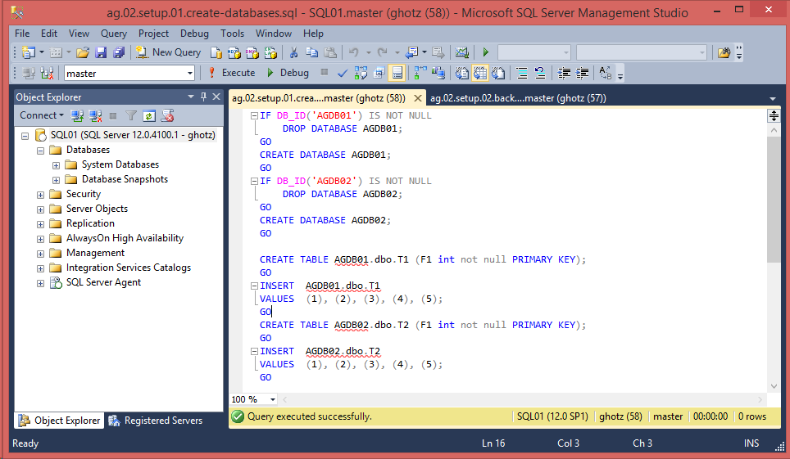
Step-by-step AG
Create sample databases

Slide 57
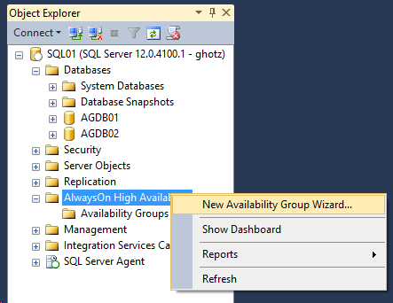
Step-by-step AG
Select Availability Groups Wizard

Slide 58
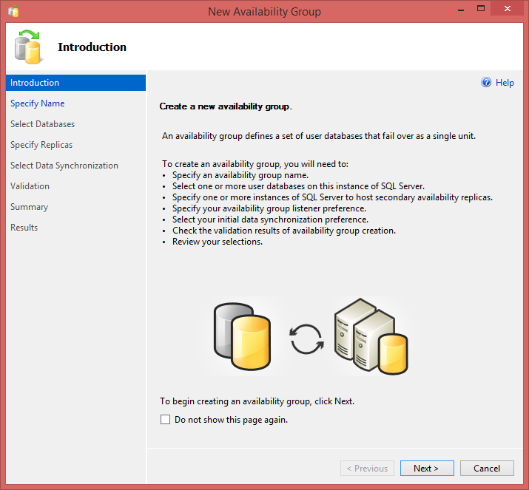
Step-by-step AG
AG Wizard: Start

Slide 59
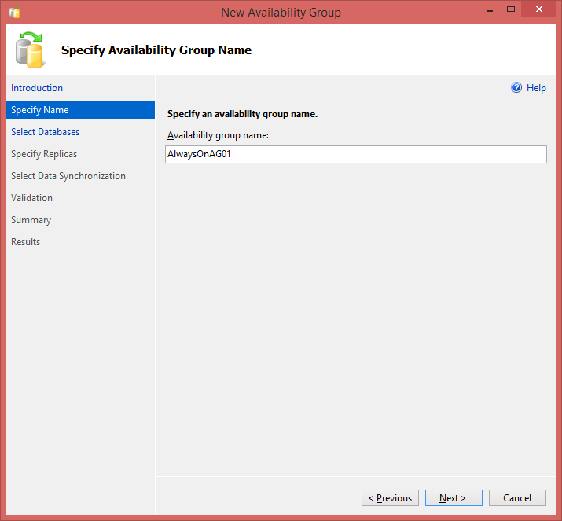
Step-by-step AG
AG Wizard: Assign Name to Group

Slide 60
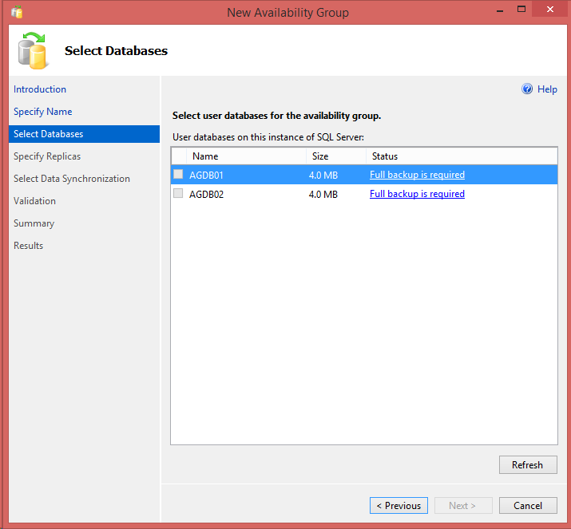
Step-by-step AG
AG Wizard: full backup required to choose a database
Notes:
During the demo, I do the backup on the fly (it only takes a couple of seconds)

Slide 61
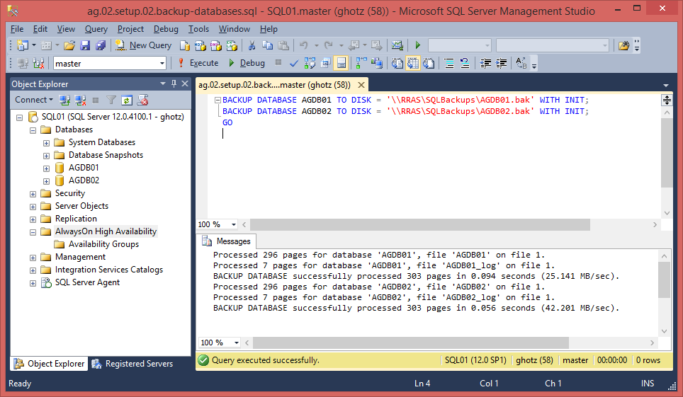
Step-by-step AG
AG Wizard: execute full backup
Notes:
During the demo, I do the backup on the fly (it only takes a couple of seconds)

Slide 62
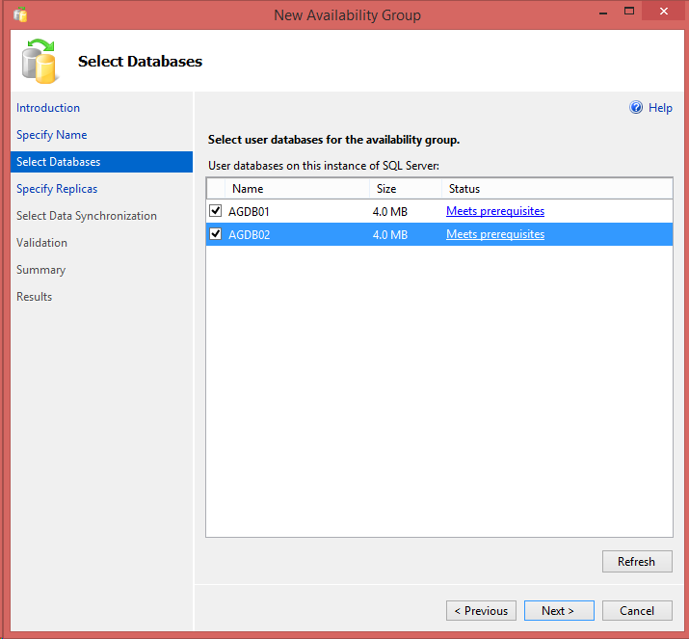
Step-by-step AG
AG Wizard: Select databases
Notes:
During the demo, I do the backup on the fly (it only takes a couple of seconds)

Slide 63
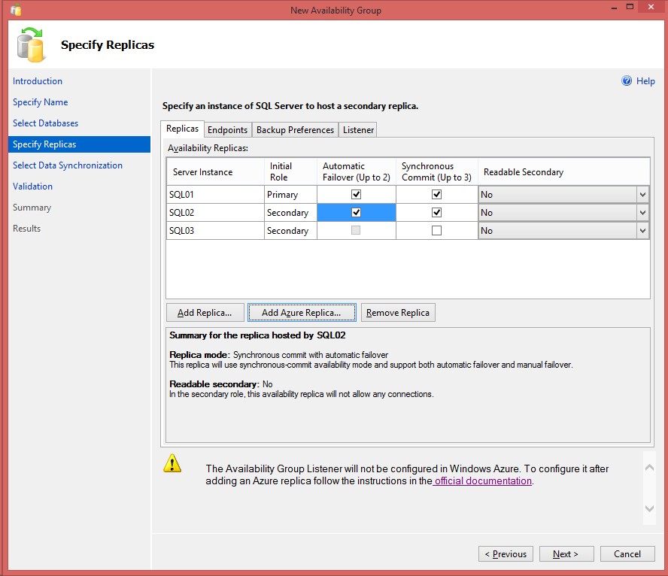
Step-by-step AG
AG Wizard: configure Replicas
Notes:
Here is where I explain that you need to remember to select automatic failover and synchronous commit for *both* the primary and the secondary to avoid unexpected results because of role exchange after a failover (check the mail with the Connect item from Richard).
Also: I choose to leave secondaries non readable because that is the second part of the demo.

Slide 64
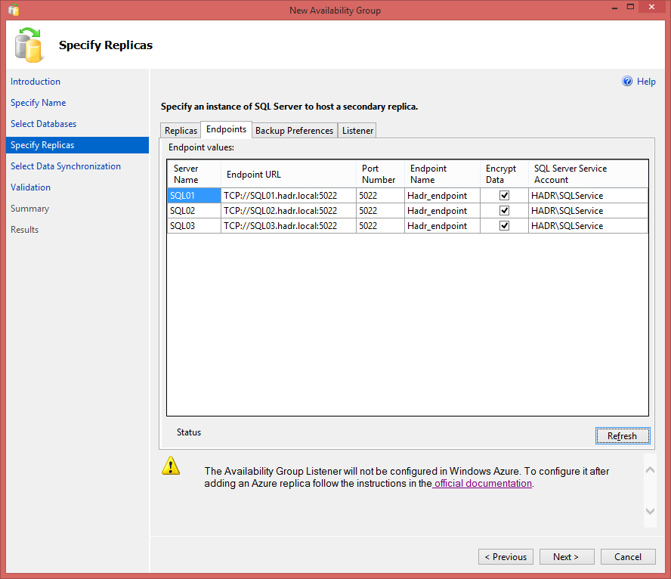
Step-by-step AG
AG Wizard: configure Endpoints with Domain User service account

Slide 65
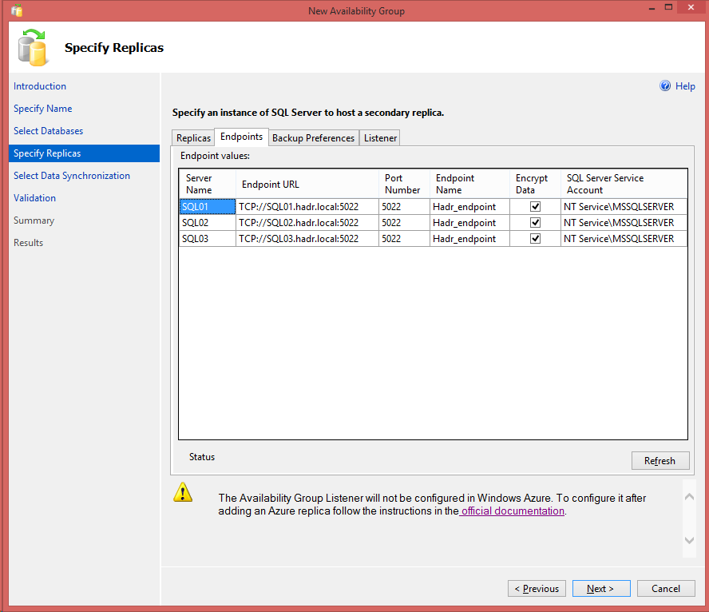
Step-by-step AG
AG Wizard: configure Endpoints without Domain User service account

Slide 66
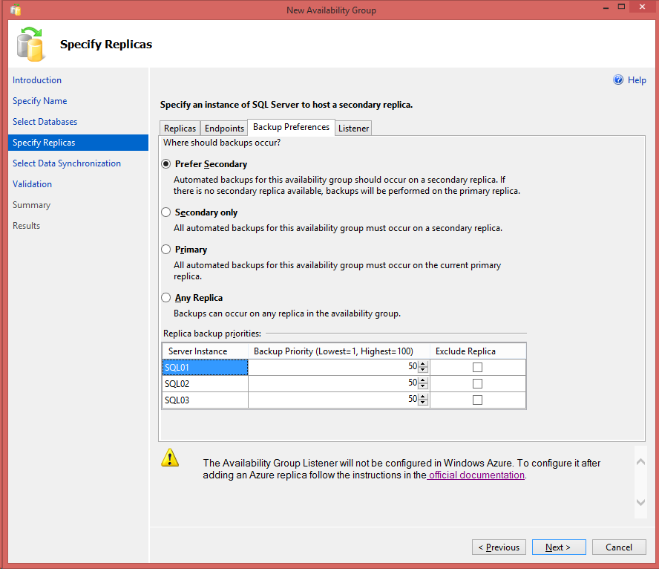
Step-by-step AG
AG Wizard: configure Backup preferences
Notes:
Here I stress again the fact that there’s no automation behind it, you need to provide the logic in your backup scripts. Also, in some cases you may want to just do backups on the DR site regardless of these settings; just because you want to have a copy of them at the DR site for redundancy and saving the extra bandwidth required to copy them of-site.

Slide 67
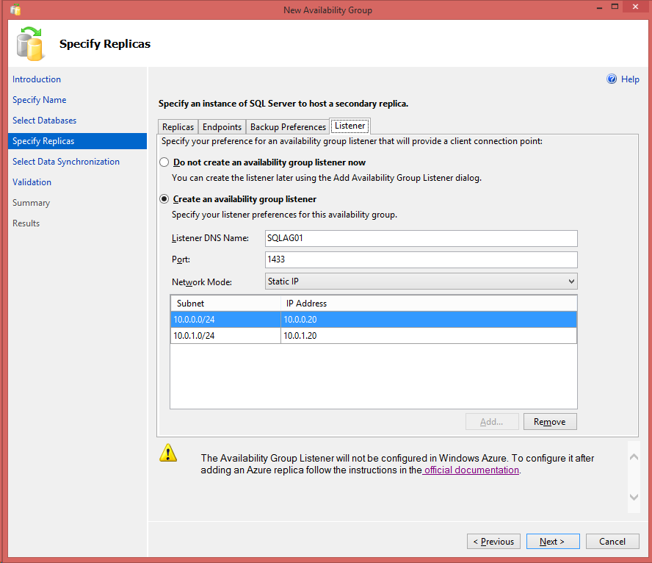
Step-by-step AG
AG Wizard: configure Listener
Notes:
Ok, when I did the live demo I simply forgot about this ☺ was not really a problem, I put on my poker face and told them it was on purpose to show them how you can configure it later ☺

Slide 68
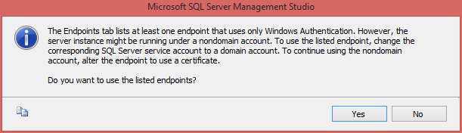
Step-by-step AG
AG Wizard: warning about services accounts
Notes:
Ok, when I did the live demo I simply forgot about this ☺ was not really a problem, I put on my poker face and told them it was on purpose to show them how you can configure it later ☺

Slide 69
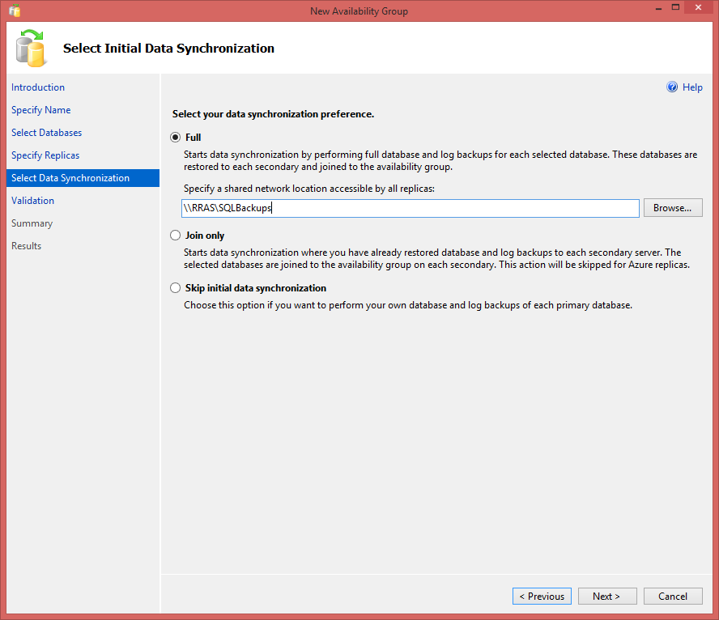
Step-by-step AG
AG Wizard: configure data synchronization
Notes:
The Temp share is not available on the VMs, for the demo I decided to build it on-the-fly, it only takes a few clicks and I ask the audience «So, to which Windows Account should I give rights to?»

Slide 70
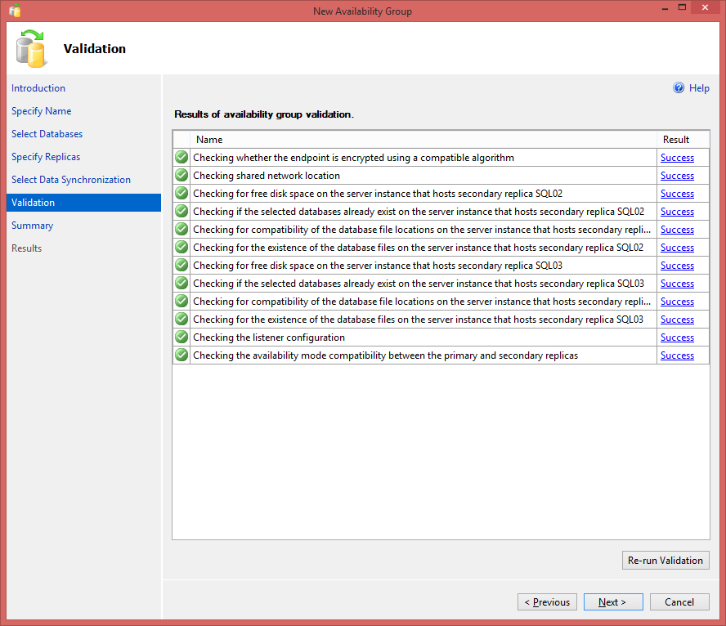
Step-by-step AG
AG Wizard: Validation

Slide 71
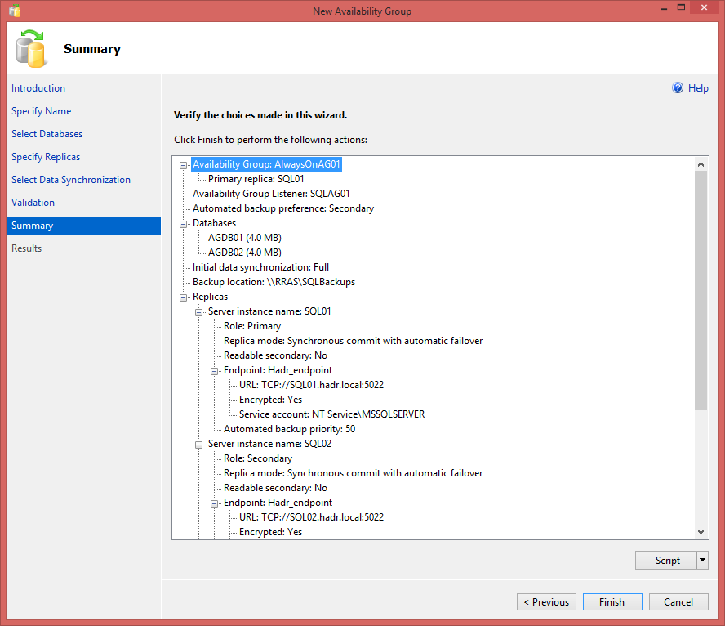
Step-by-step AG
AG Wizard: Summary

Slide 72
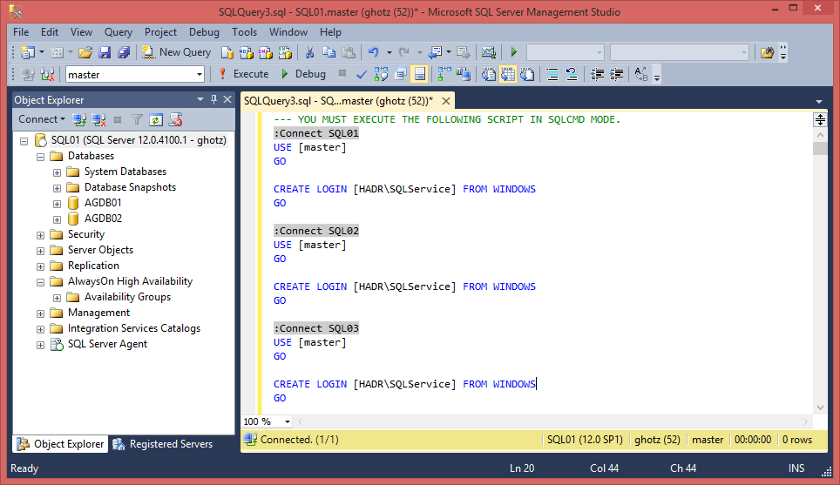
Step-by-step AG
AG Wizard: Script

Slide 73
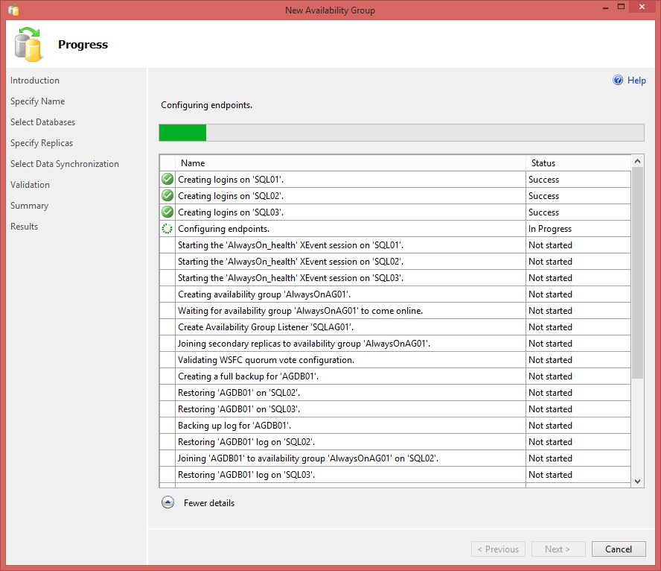
Step-by-step AG
AG Wizard: Progress

Slide 74
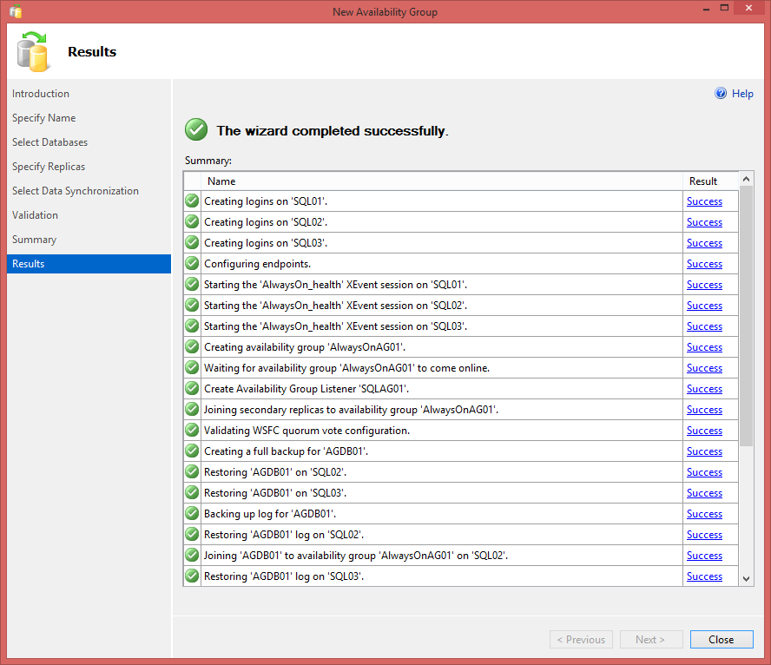
Step-by-step AG
AG Wizard: Results
Notes:
The warning is because the current quorum vote configuration is against best practices.
From what I understood, this is because the third instance SQL3 is asynchronous and because failover can be only manual, it’s sort of implied that this instance is for DR and thus the node hosting it shouldn’t be allowed to vote. http://msdn.microsoft.com/en-us/library/hh270280.aspx

Slide 75
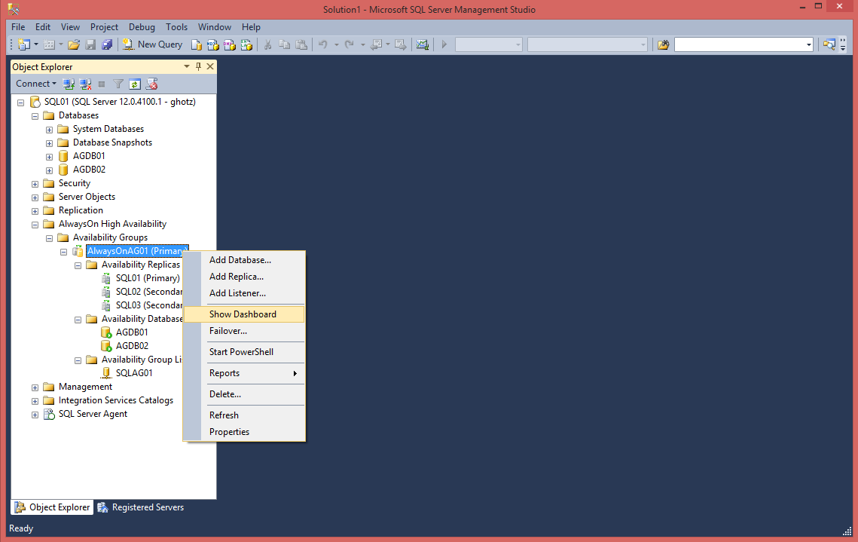
Step-by-step AG
AG open Dashboard

Slide 76
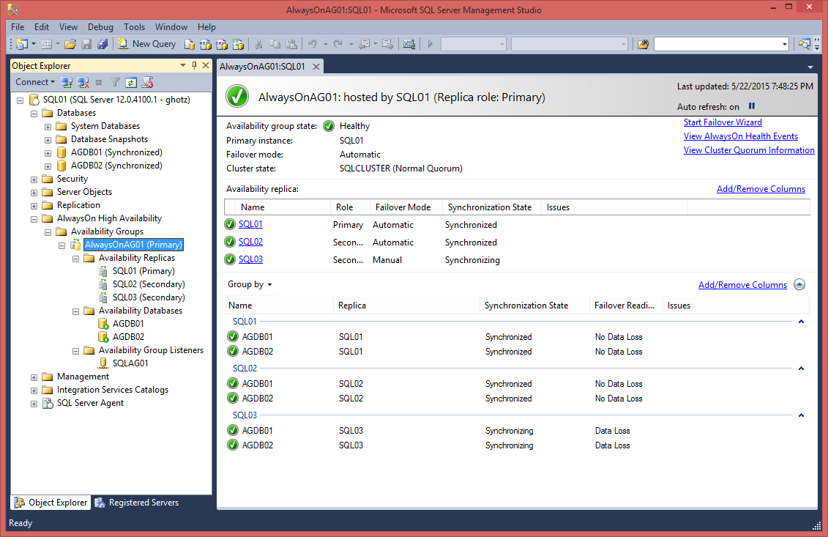
Step-by-step AG
AG Dashboard

Slide 77
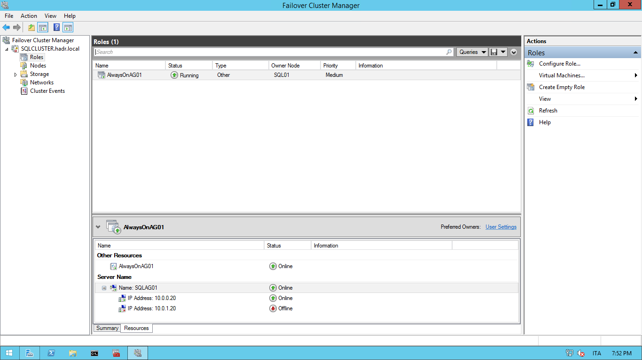
Step-by-step AG
Cluster configuration of AG after installation
Notes:
Stress out that there’s no shared storage! This is a complete solution without shared storage and the need to replicate it with a proprietary technology.

Slide 78
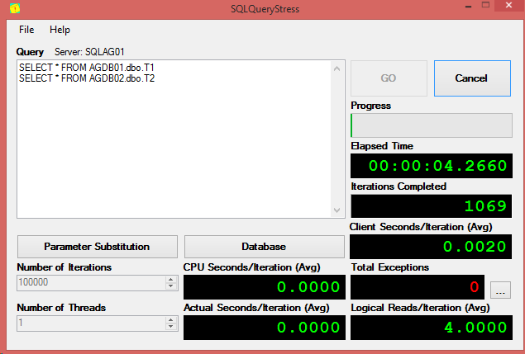
Step-by-step AG
Simulate a failure: start a workload
Notes:
I ran this on the Domain Controller

Slide 79
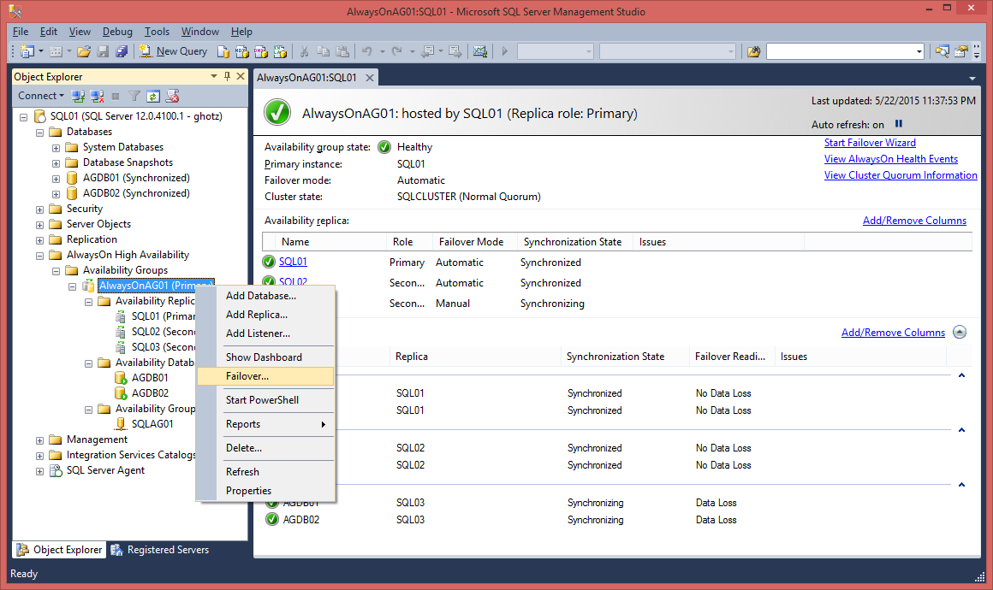
Step-by-step AG
Simulate a failure: start a manual Failover

Slide 80
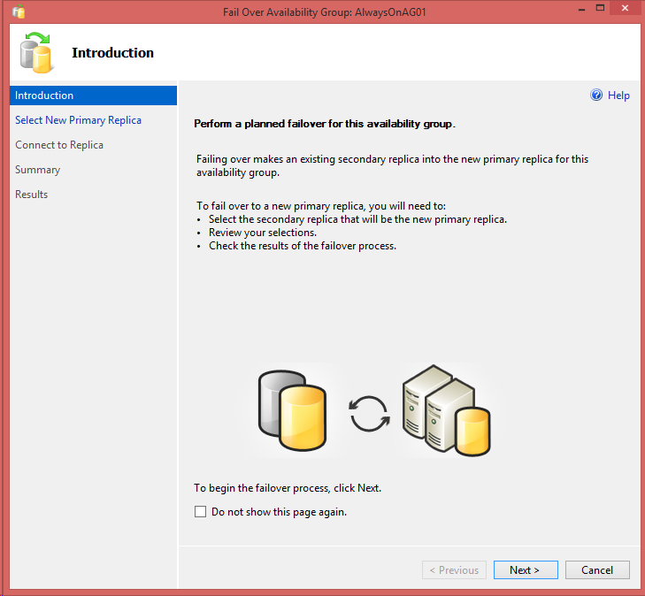
Step-by-step AG
Failover Wizard: Introduction

Slide 81
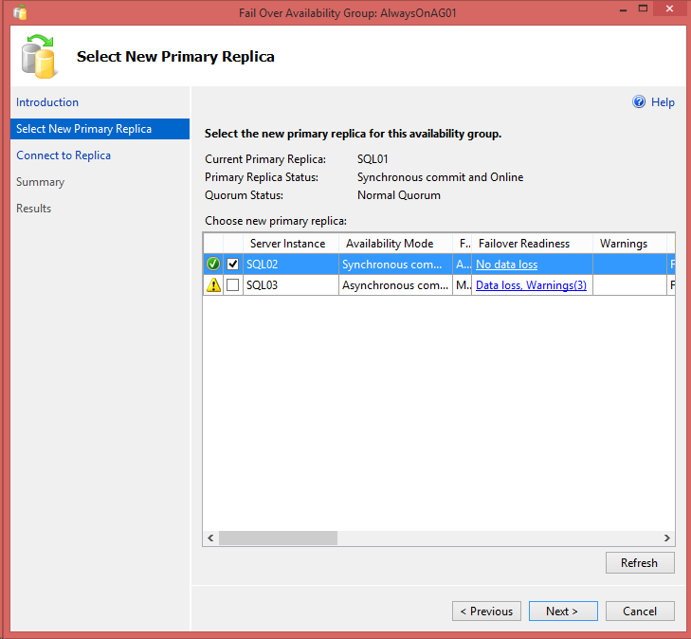
Step-by-step AG
Failover Wizard: select new Primary Replica

Slide 82
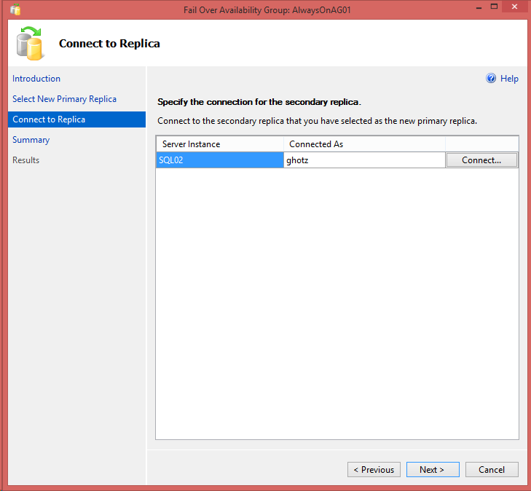
Step-by-step AG
Failover Wizard: connect to Secondary Replica

Slide 83
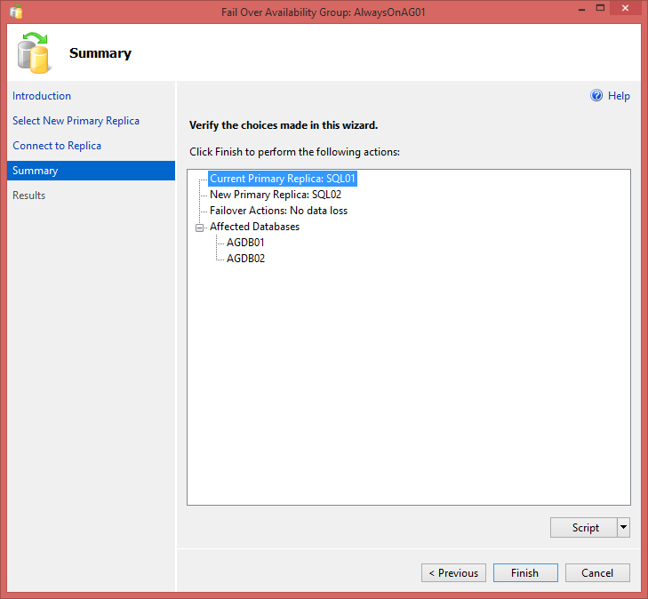
Step-by-step AG
Failover Wizard: Summary

Slide 84
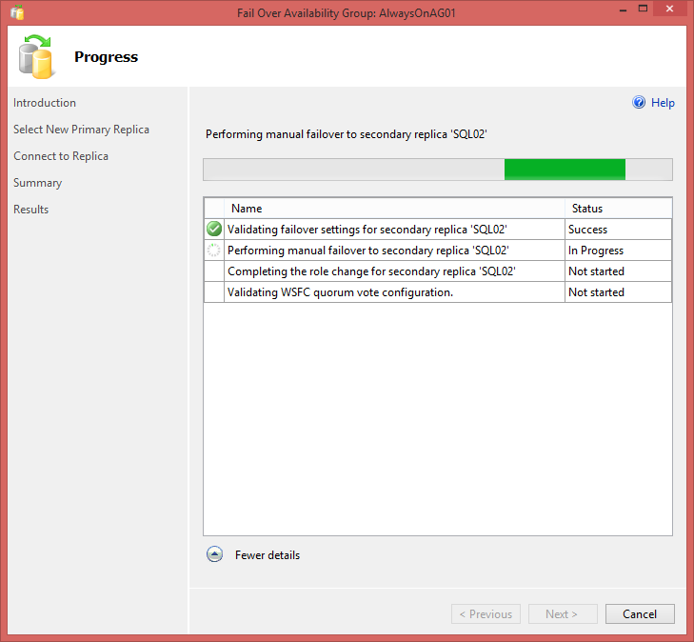
Step-by-step AG
Failover Wizard: Progress

Slide 85
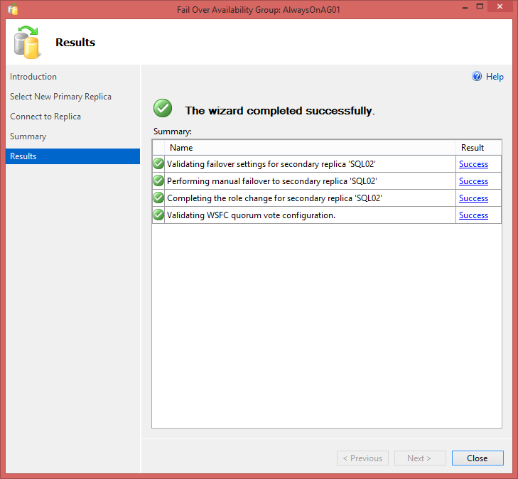
Step-by-step AG
Failover Wizard: Complete

Slide 86
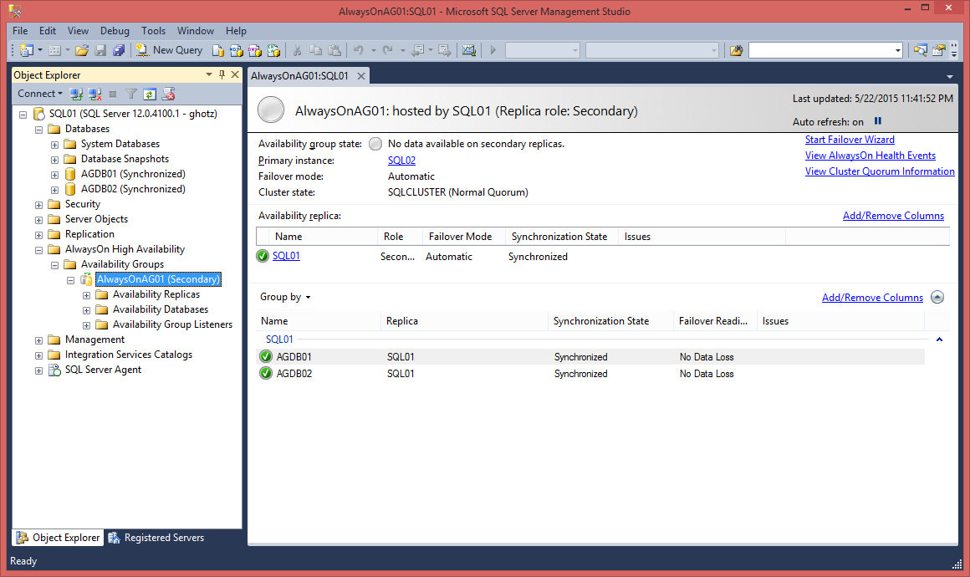
Step-by-step AG
Simulate a failure: Dashboard on new Secondary Replica

Slide 87
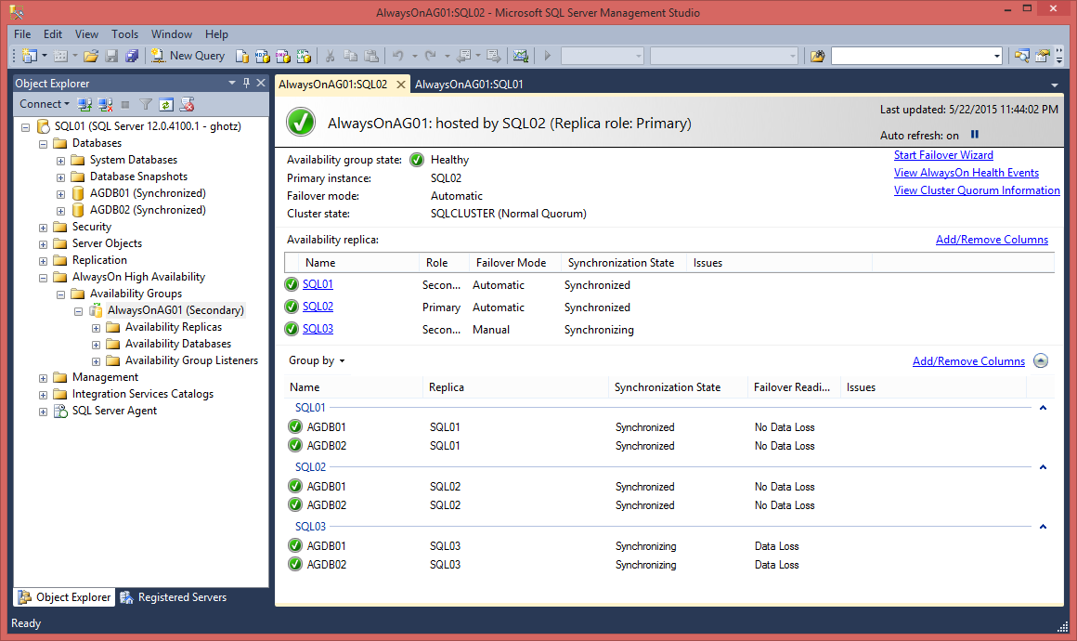
Step-by-step AG
Simulate a failure: Dashboard on new Primary Replica

Slide 88
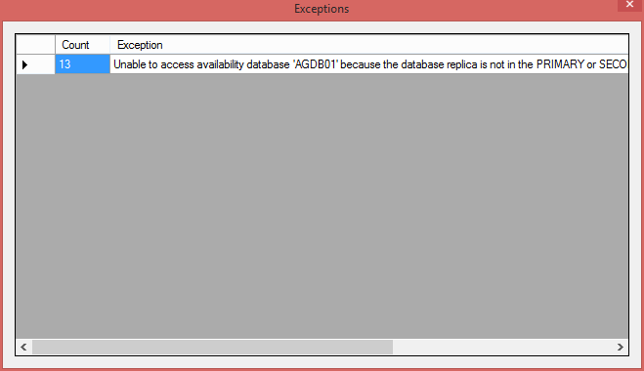
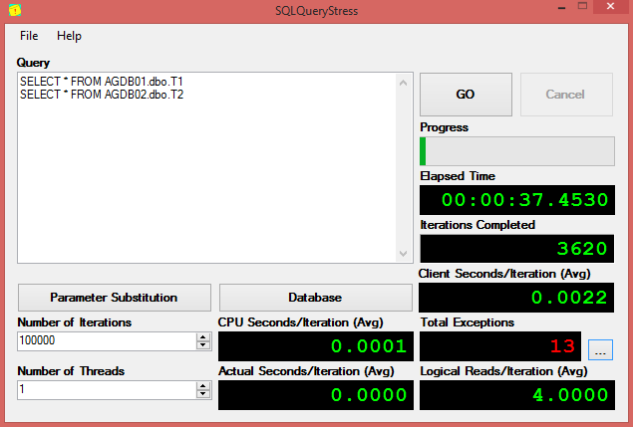
Step-by-step AG
Simulate a failure: clients exceptions
Notes:
Ok, at this point I show also how to rollback. You may choose to skip it, however mind that everything from this point on assumes the Primary Replica is SQL1 and the Secondary Replica is on SQL2

Slide 89
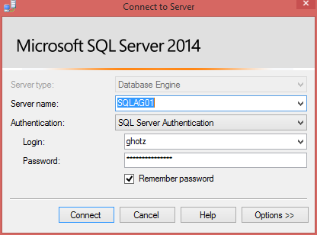
Step-by-step AG
Accessing AG: connecting to the Listener’s VNN

Slide 90

Step-by-step AG
Accessing AG: querying the Listener’s VNN
Notes:
Note: the connection is done against the Virtual Network Name which was setup up with the Listener.
Here you show that you land on the first node, SQL1, the one hosting the Primary Replica.

Slide 91

Step-by-step AG
Accessing AG: connecting directly to Secondary Replica
Notes:
Note: it is important to show we are connecting to the instance directly, because later we’ll say that it kind of defeats the whole idea of having a Listener and we will introduce Read Only routing whch is only available if applications can change their connection strings.

Slide 92

Step-by-step AG
Accessing AG: Secondary Replica not accessible
Notes:
You correctly land on the second node, SQL2 hosting the secondary replica, but you can’t access.

Slide 93

Step-by-step AG
Accessing AG: configure readable Secondary Replica
Notes:
Point out we are not allowing it for the third one because it’s the DR site which is geographically distant and possibly with high latency.

Slide 94

Step-by-step AG
Accessing AG: readable Secondary Replica
Notes:
The replica is now readable.
Now, point out that it works but we had to connect to the SQL Server instance directly which kind of defeats the whole idea of having a Listener and a VNN.
This can be solved using Read Only routing.

Slide 95

Step-by-step AG
Accessing AG: configure Application Intent
Notes:
Se setup the Availability Groups so that when a Replica’s role is Primary, it allows read/write applications and when the role is Secondary, it allows Read-intent only.
We leave the third one allowing all connections and no secondary because it’s the DR site in our scenario.

Slide 96
Step-by-step AG
Accessing AG: VNN without Application Intent
Notes:
When we try to connect using the VNN without specyfing any intent…

Slide 97

Step-by-step AG
Accessing AG: VNN without Application Intent defaults to read/write
Notes:
… by default the intent is read/write and we end up on the Primary Replica.

Slide 98


Step-by-step AG
Accessing AG: VNN with Read Only Application Intent
Notes:
Applications need to specify read only intent if they wish to be switched to the correct replica…

Slide 99

Step-by-step AG
Accessing AG: VNN with Read Only Application Intent still on Primary
Notes:
We still land on the Primary Replica

Slide 100

Step-by-step AG
Accessing AG: Read Only Routing configuration
Notes:
We need to be sure that both Read Only Routing URLs and Read Only Routing Lists are configured

Slide 101

Step-by-step AG
Accessing AG: VNN with Read Only Application Intent again on Primary
Notes:
Wait a minute what’s going on here! We still land on the Primary Replica!

Slide 102

Step-by-step AG
Accessing AG: VNN with Read Only Application Intent and database name
Notes:
We need everything: to connect to the VNN, to specify the Read Only Application Intent *and* to specify an Availability Database.

Slide 103

Step-by-step AG
Accessing AG: Read Only Routing working!
Notes:
Finally!

Slide 104
AlwaysOn
WSFC: Quorum, votes and DR site
Quorum
Majority Node, Majority Node and Fileshare
Can’t use Quorum Disk without shared storage
Windows 2008 e 2008 R2 + QFE
Allow to assign voting rights to nodes
Avoid scenarios where DR site takes over
Common scenario is to always failover manually to DR site i.e. DR site is not considered for HA

Slide 105
AlwaysOn
WSFC: Asymmetric Storage
Windows 2008 + QFE or 2008 R2 + SP1
Disks shared only among some nodes
E.g. one SAN on primary site and one SAN on DR site, volumes shared only among local nodes while the cluster stretches across sites
Allows new Quorum models
Asymmetric Disk Majority
Node Majority + Asymmetric Disk Majority
Notes:
Sounds crazy eh?

Slide 106



AlwaysOn
Topology Example 2
A
A
A
Shared storage, regional and geo secondaries
Asynchronous data movement

Slide 107

AlwaysOn
Multi-site FCI+AG scenario

Slide 108
AlwaysOn AG
Hybrid Cloud
Run backups
Windows Azure
Run BI reports
Secondary Replica
Asynchronous Commit
VPN Tunnel (Windows Azure Virtual Network)
On-Premise Network
Domain Controller
Synchronous Commit
Primary Replica
Secondary Replica

Slide 109
AlwaysOn
SQL Server 2012 Design Patterns
AlwaysOn Solution | Characteristics | Pre AlwaysOn corresponding solution
Multi-site FCI for HA and DR | Shared Storage solution Instance Level HA Instance Level DR Doesn’t require database to be in FULL recovery model | Multi-site FCI using stretch VLAN
Availability Group for HA and DR | Non-Shared Storage solution (Group of) Database Level HA (Group of) Database Level DR DR replica can be Active Secondary Requires database to be in FULL recovery model | Database Mirroring for Local HA and Log Shipping for DR
Failover Cluster Instance for local HA + Availability Group for DR | Combined Shared Storage and Non-Shared Storage Instance Level HA (Group of) Database Level DR DR replica can be Active Secondary Requires database to be in FULL recovery model | FCI for Local HA and Database Mirroring for DR
Notes:
First one: you still need a shared storage replication proprietary solution as far as I understand.
Anymetric stuff is needed for the last one.
You really need to refer to the Airlift material and the PASS presentation to make sense of these patterns…

Slide 110
AlwaysOn
Availability Groups in SQL Server 2014
Up to 8 secondary replicas (was 4)
still only 2 can be in synchronous mode
Secondary readable replicas remain online
when disconnected from primary
When there’s a quorum loss
New DMV
sys.fn_hadr_is_primary_replica
Add Azure Replica Wizard

Slide 111
AlwaysOn
Availability Groups in SQL Server 2016
Up to 3 synchronous secondary replicas (was 2)
DTC Support
Round robin balancing of secondary replicas

Slide 112
AlwaysOn
Minimum HA/DR support for non Enterprise editions
Server Core
Log Shipping (except on Express)
Database Mirroring
Deprecated!
Synchronous only for BI/Standard
Witness only for Web/Express
Failover Clustering Instance
2 nodes for BI/Standard
Purely passive nodes licensing as in 2008

Slide 113


AlwaysOn
Other Hybrid Cloud Scenarios
Database Mirroring
VPN not needed for domain authentication
Can use certificate based authentication
Log Shipping
Image source: http://msdn.microsoft.com/en-us/library/jj870962.aspx
Image source: http://msdn.microsoft.com/en-us/library/jj870962.aspx

Slide 114

AlwaysOn AG
AG+Log Shipping Scenario
http://technet.microsoft.com/en-us/library/dn635313(v=office.15).aspx

Slide 115
AlwaysOn
Change in licensing
Software Assurance needed for passive servers
“Beginning with SQL Server 2014, each active server licensed with SA coverage allows the installation of a single passive server used for fail-over support.”
“The active server license (s) must be covered with SA, and allow for one passive secondary SQL Server, with up to the same amount of compute as the licensed active server, only.”
Impacts everything: log shipping, mirroring, AG
From SQL Server 2014 Licensing Datasheet
http://download.microsoft.com/download/6/6/F/66FF3259-1466-4BBA-A505-2E3DA5B2B1FA/SQL_Server_2014_Licensing_Datasheet.pdf

Slide 116
AlwaysOn
AG Main Resources
Books Online
SQL AlwaysOn Blog
http://blogs.msdn.com/b/sqlalwayson
CSS SQL Server Engineers
http://blogs.msdn.com/b/psssql/archive/tags/alwayson
SQL CAT
http://sqlcat.com
Previously named HADRON
Keep in mind when searching articles
Still present in some DMVs (_hadr_)

Slide 117
AlwaysOn
AG Whitepapers series: AlwaysOn HA/DR architectures and design patterns
AlwaysOn Architecture Guide: Building a High Availability and Disaster Recovery Solution by Using AlwaysOn Availability Groups
http://msdn.microsoft.com/en-us/library/jj191711.aspx
AlwaysOn Architecture Guide: Building a High Availability and Disaster Recovery Solution by Using Failover Cluster Instances and Availability Groups
http://msdn.microsoft.com/en-us/library/jj215886.aspx
AlwaysOn Solution Guide: Offloading Read-Only Workloads to Secondary Replicas
http://msdn.microsoft.com/en-us/library/jj542414.aspx
Cross-cluster Migration of AlwaysOn Availability Groups for Operating System Upgrades
http://msdn.microsoft.com/en-us/library/jj873730.aspx
Microsoft SQL Server AlwaysOn Solutions Guide for High Availability and Disaster Recovery
http://msdn.microsoft.com/en-us/library/hh781257.aspx
Migration Guide: Migrating to AlwaysOn Availability Groups from Prior Deployments Combining Database Mirroring and Log Shipping
http://msdn.microsoft.com/en-us/library/jj635217.aspx
Multisite Failover Cluster Instance
http://sqlcat.com/sqlcat/b/whitepapers/archive/2011/12/22/sql-server-2012-alwayson_3a00_-multisite-failover-cluster-instance.aspx
SQL Server 2012 AlwaysOn High Availability and Disaster Recovery Design Patterns
http://sqlcat.com/sqlcat/b/msdnmirror/archive/2011/12/22/sql-server-2012-alwayson-high-availability-and-disaster-recovery-design-patterns.aspx

Slide 118
Q&A
Domande?

Slide 119

Thanks!
#sqlsatTorino
#sqlsat400
SPEAKERSCORE
http://speakerscore.com/MK1T

